Slide 1

Materialize
Responsive Web Framework based on Material Design

Slide 2

Materialize
Materialize is a modern responsive web framework based on Google’s Material Design, created by 4 students of Carnegie Mellon University, Australia, started in 2014.
Material Design is a design language that combines the classic principles of successful design along with innovation and technology.
More information visit: materializecss.com

Slide 3

Setup
#1 Online
Insert CDN link (Works Online) https://materializecss.com/getting-started.html
Insert this CSS link to <head> tag:
<link rel="stylesheet" href="https://cdnjs.cloudflare.com/ajax/libs/materialize/1.0.0-rc.2/css/materialize.min.css">
Insert this JS link to the lower part of <body> tag:
<script src="https://cdnjs.cloudflare.com/ajax/libs/materialize/1.0.0-rc.2/js/materialize.min.js"></script>

Slide 4
Download locally (Works Offline). First, download Materialize then extract it. Insert its folders (css & js) to your project dir & link it to your HTML file.
Setup
#2 Offline
Insert this CSS link to <head> tag:
<link rel="stylesheet" type="text/css" href="css/materialize.min.css">
Insert this JS link to the lower part of <body> tag:
<script type="text/javascript" src="js/materialize.min.js"></script>

Slide 5
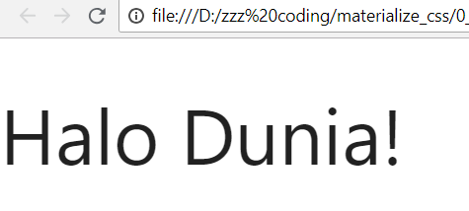
Your 1st Materialize Code
<!DOCTYPE html>
<html>
<head>
<link rel="stylesheet" type="text/css"
href="css/materialize.min.css">
<title>Tes Materialize</title>
</head>
<body>
<h1>Halo Dunia!</h1>
<script type="text/javascript"
src="js/materialize.min.js"></script>
</body>
</html>

Slide 6
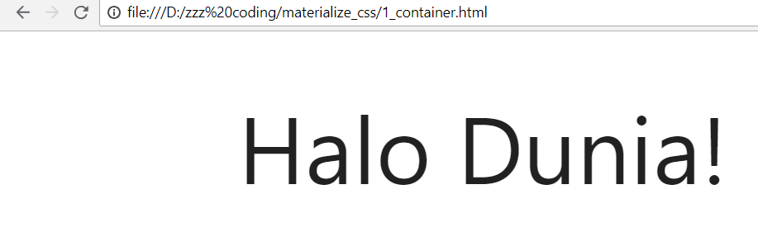
Container
<div class="container">
<h1>Halo Dunia!</h1>
</div>
margin

Slide 7
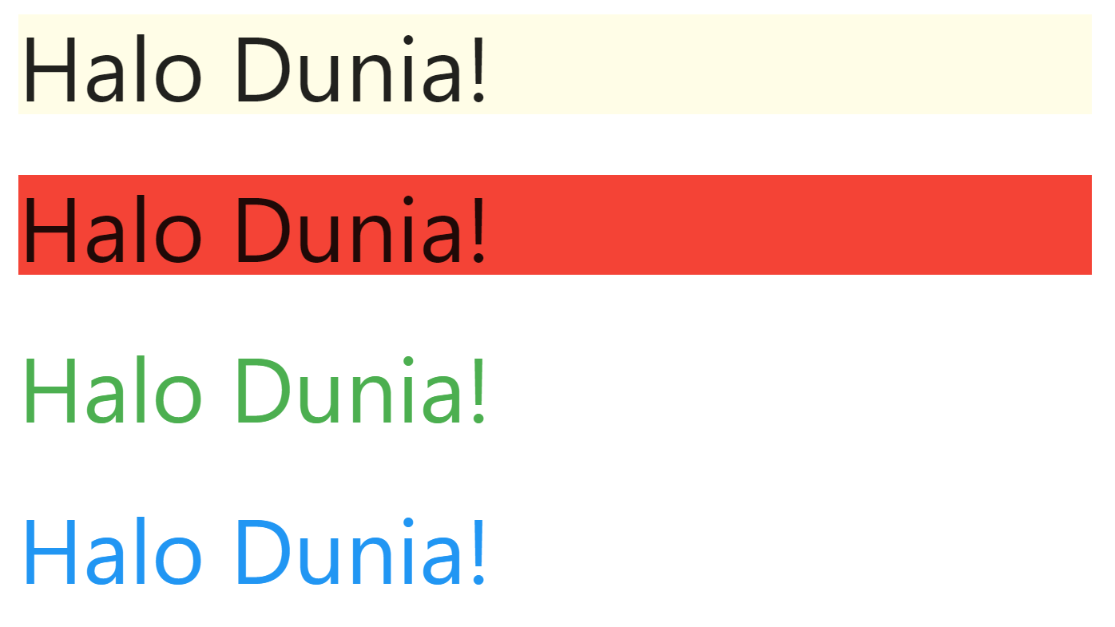
Colors
<h1 class="yellow lighten-5">
Halo Dunia!
</h1>
<h1 class="red darken-5">Halo Dunia!</h1>
<h1 class="green-text">Halo Dunia!</h1>
<h1 class="blue-text text-darken-5">
Halo Dunia!
</h1>

Slide 8
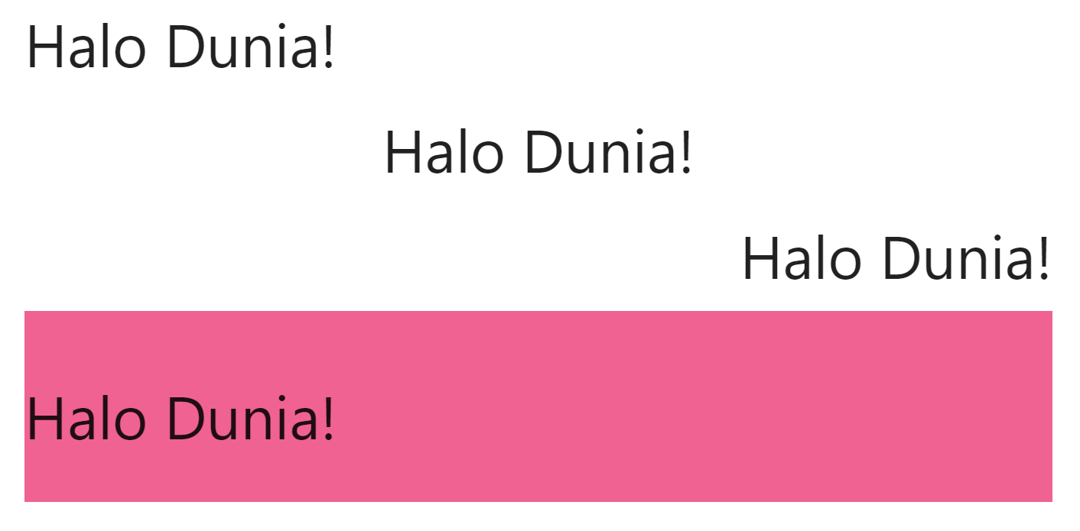
Alignment
<h1 class="left-align">Halo Dunia!</h1>
<h1 class="center-align">Halo Dunia!</h1>
<h1 class="right-align">Halo Dunia!</h1>
<div class="valign-wrapper pink lighten-2" style="height:200px">
<h1>Halo Dunia!</h1>
</div>

Slide 9
Visibility
Add one of these classes to
set visibility of your elements:
hide-on-small-only
hide-on-small-and-down
hide-on-med-and-down
hide-on-med-and-up
hide-on-med-only
hide-on-large-only
show-on-large
show-on-medium
show-on-small
show-on-medium-and-up
show-on-medium-and-down

Slide 10
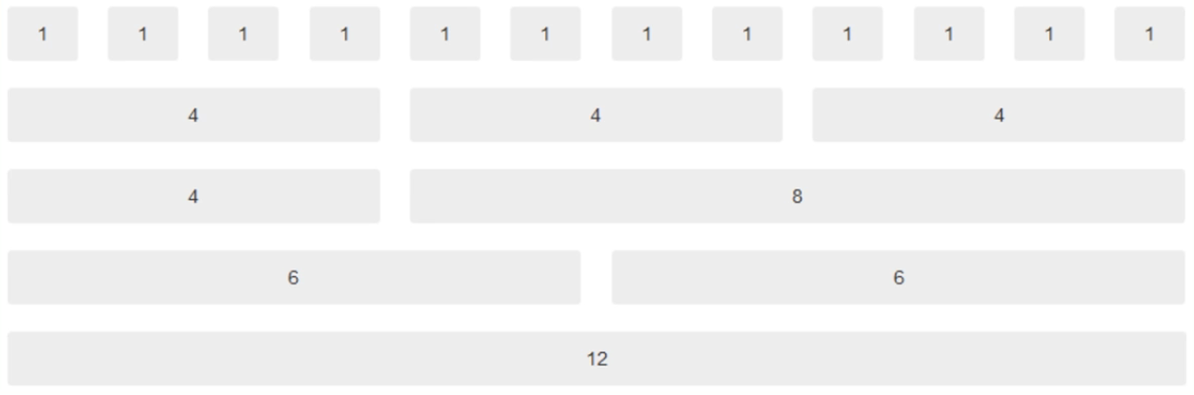
Grid System
Materialize comes with a 12 columns grid system. We can add our content into its ‘rows’ & ‘columns’ using Materialize’s CSS classes.

Slide 11
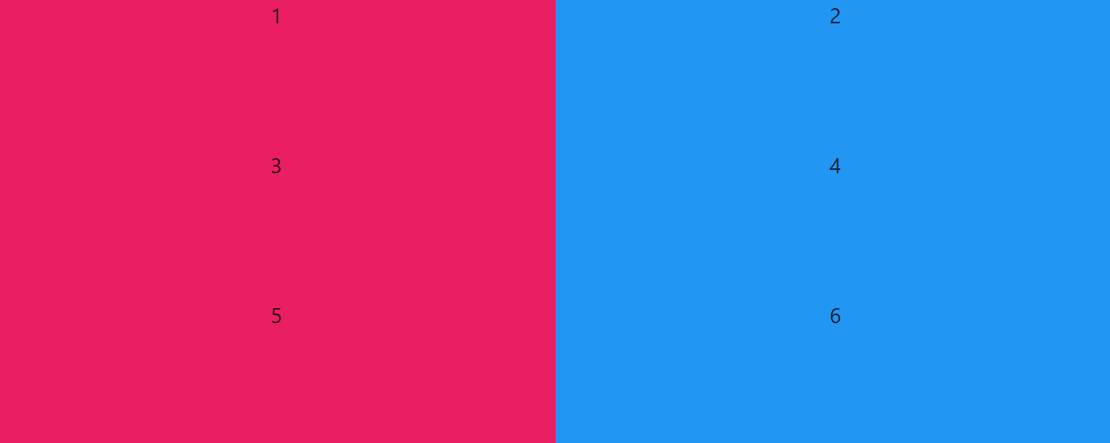
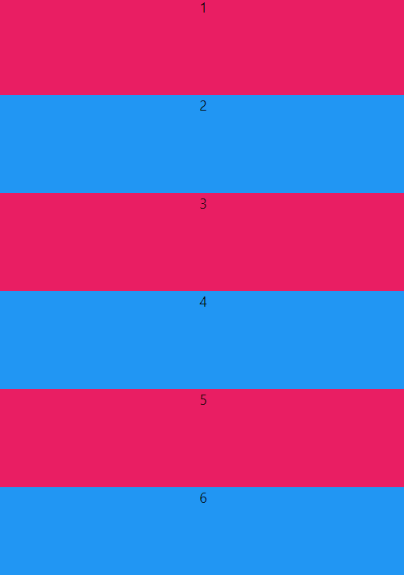
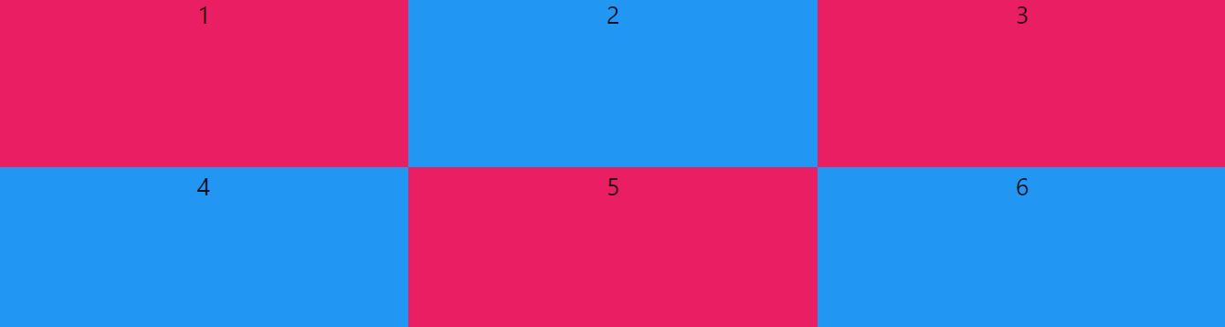
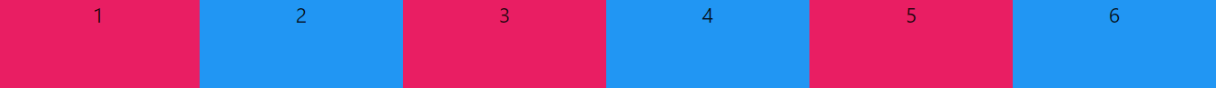
s < 600px
m > 600px
l > 992px
xl >= 1200px

Slide 12
Grid
<head>
<style>
.tengah{
text-align: center; height: 100px;
}
</style>
</head>
<body>
<div class="container">
<div class="row">
<div class="col s12 m6 l4 xl2 pink tengah">1</div>
<div class="col s12 m6 l4 xl2 blue tengah">2</div>
<div class="col s12 m6 l4 xl2 pink tengah">3</div>
<div class="col s12 m6 l4 xl2 blue tengah">4</div>
<div class="col s12 m6 l4 xl2 pink tengah">5</div>
<div class="col s12 m6 l4 xl2 blue tengah">6</div>
</div>
</div>
</body>

Slide 13
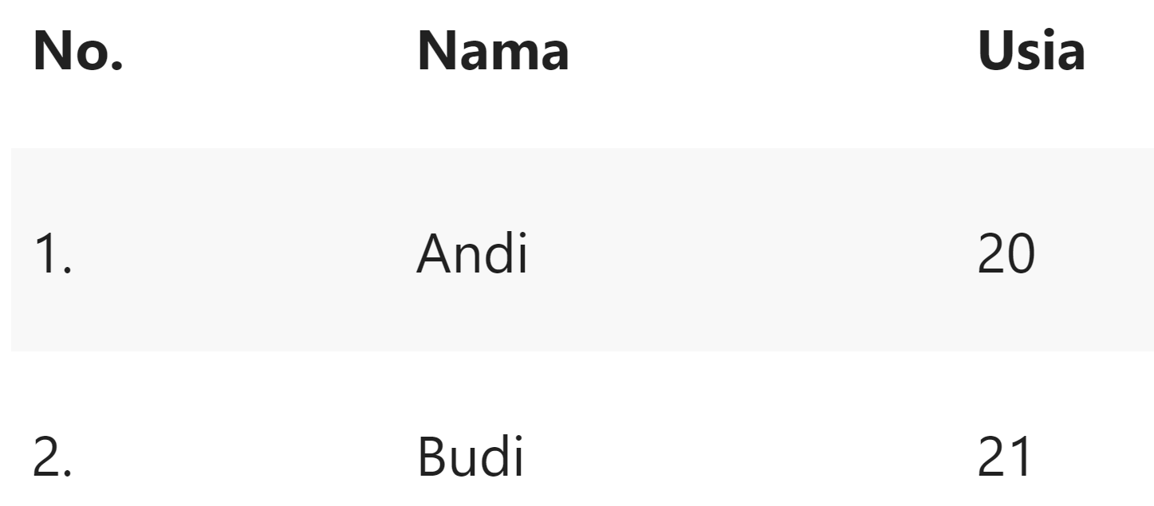
Table
<table class="striped">
<thead>
<tr>
<th>No.</th><th>Nama</th><th>Usia</th>
</tr>
</thead>
<tbody>
<tr>
<td>1.</td><td>Andi</td><td>20</td>
</tr>
</tbody>
</table>
class: striped, highlight,
centered, responsive-table

Slide 14
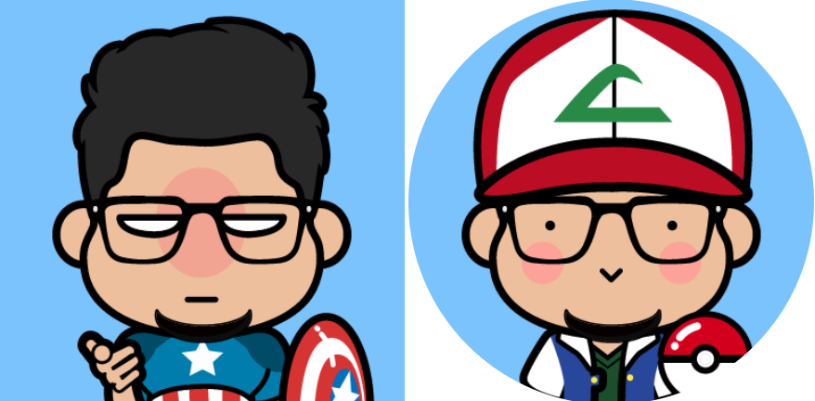
Image
<div class="container">
<img src="img/1.png" class="responsive-img">
<img src="img/2.png" class="responsive-img circle">
</div>

Slide 15
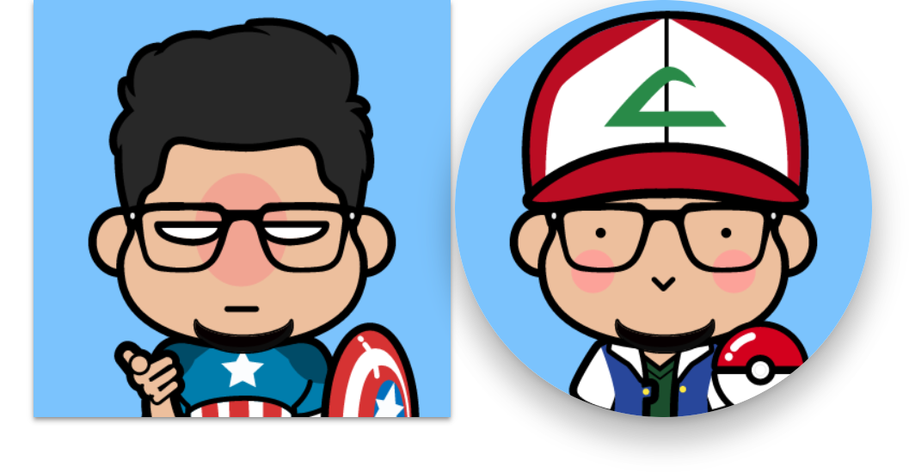
Shadow
<div class="container">
<img src="img/1.png"
class="z-depth-2 responsive-img">
<img src="img/2.png"
class="z-depth-5 responsive-img circle">
</div>

Slide 16
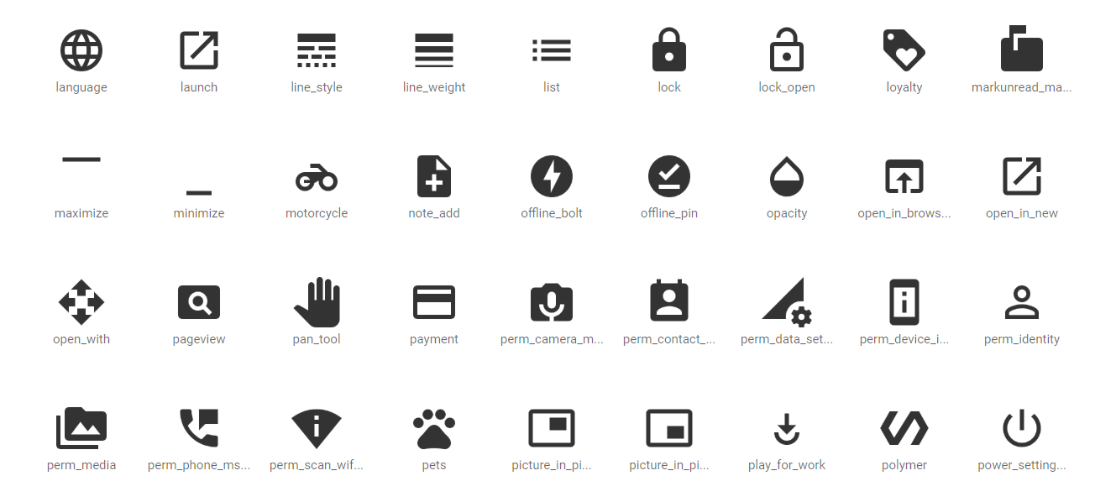
Icon
Insert line below into <head> tag:
<link href="https://fonts.googleapis.com/icon?
family=Material+Icons" rel="stylesheet">
List of icons: https://material.io/tools/icons

Slide 17
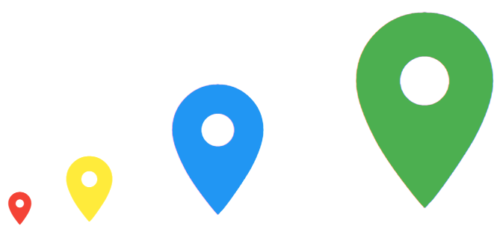
Icon
<i class="material-icons tiny red-text">
room</i>
<i class="material-icons small yellow-text">
room</i>
<i class="material-icons medium blue-text">
room</i>
<i class="material-icons large green-text">
room</i>

Slide 18
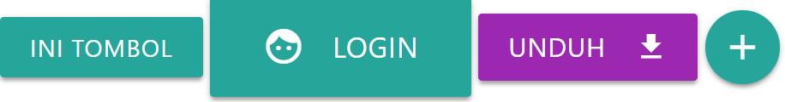
Button
<a class="waves-effect waves-light btn btn-small">
ini tombol</a>
<a class="waves-effect waves-light btn btn-large">
<i class="material-icons left">face</i>login</a>
<a class="waves-effect waves-light btn purple">
<i class="material-icons right">get_app</i>unduh</a>
<a class="waves-effect waves-light btn-floating">
<i class="material-icons">add</i></a>

Slide 19
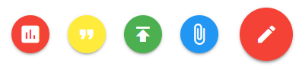
FAB
<div class="fixed-action-btn">
<a class="btn-floating btn-large red">
<i class="large material-icons">mode_edit</i>
</a>
<ul>
<li><a class="btn-floating red">
<i class="material-icons">insert_chart</i></a></li>
<li><a class="btn-floating yellow">
<i class="material-icons">format_quote</i></a></li>
<li><a class="btn-floating green">
<i class="material-icons">publish</i></a></li>
<li><a class="btn-floating blue">
<i class="material-icons">attach_file</i></a></li>
</ul>
</div>

Slide 20
FAB
Adding jQuery
<script>
$(document).ready(function(){
$('.fixed-action-btn').floatingActionButton({
direction: 'left',
hoverEnabled: true,
});
});
</script>

Slide 21
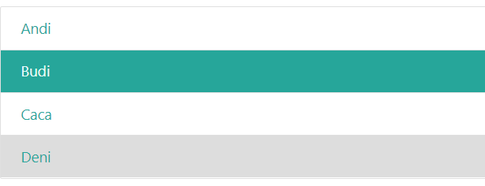
Collection
<div class="collection">
<a href="#" class="collection-item">
Andi</a>
<a href="#" class="collection-item active">
Budi</a>
<a href="#" class="collection-item">
Caca</a>
<a href="#" class="collection-item">
Deni</a>
</div>

Slide 22
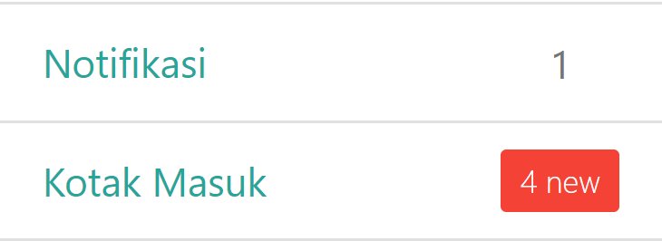
Badge
<div class="collection">
<a href="#" class="collection-item">
<span class="badge">1</span>
Notifikasi
</a>
<a href="#" class="collection-item active">
<span class="new badge red">4</span>
Kotak Masuk
</a>
</div>

Slide 23
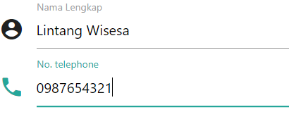
Text Input
<form>
<div class="input-field">
<i class="material-icons prefix">account_circle</i>
<input id="input1" type="text">
<label for="input1">Nama Lengkap</label>
</div>
<div class="input-field">
<i class="material-icons prefix">phone</i>
<input id="input2" type="text">
<label for="input2">No. telephone</label>
</div>
</form>

Slide 24
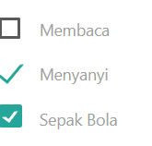
Checkbox
<p>
<label>
<input type="checkbox" />
<span>Membaca</span>
</label>
</p>
<p>
<label>
<input type="checkbox" checked="checked" />
<span>Menyanyi</span>
</label>
</p>
<p>
<label>
<input type="checkbox" class="filled-in" />
<span>Sepak Bola</span>
</label>
</p>

Slide 25
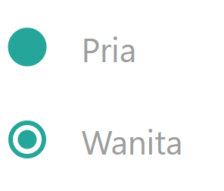
Radio Button
<p>
<label>
<input name="group1" type="radio"/>
<span>Pria</span>
</label>
</p>
<p>
<label>
<input class="with-gap" name="group1"
type="radio"/>
<span>Wanita</span>
</label>
</p>

